Slide 1




bitscity.github.io

Slide 2
Four challenge areas
Reappropriating Infrastructure
Waiting Places
Sensors in the City
Other

Slide 3
Criteria
Impactful
Does the project solve a specific problem, or generate meaningful information, or benefit a wide range of citizens?
Creative
How is the project different (and better) from previous alternatives?
Be audacious.
Realistic
Is the project do-able: commercially, technologically, and politically?
Tell us why.
Collaborative
Does the project interact with other projects (whether existing or proposed)?

Slide 4
Prize
A “Public Key” to Boston
There are sensors going up all over the city
Many will be accessible through public APIs
Set the API public key for a suite of sensors to whatever you like
Joe_schmo_is_the_bomb_111
Burritos_are_my_alpha_and_omega_01
Become a legend
Opportunity to present your idea @ announcement event to City people, potential partners, and potential investors
Plus mentorship @ City Hall + LSL and other goodies

Slide 5
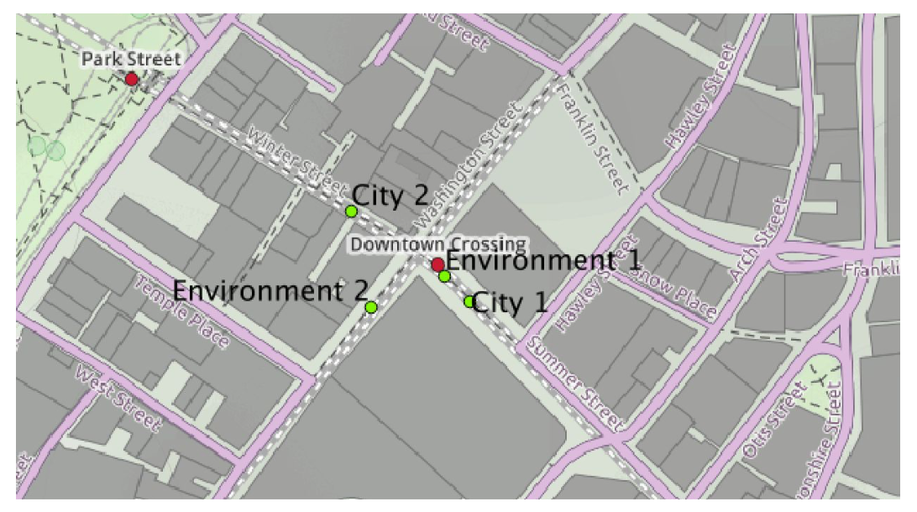
Live sensor data
Camera
Pedestrian/Vehicle
Environmental
Temperature, humidity, luminosity, noise, (relative) gas levels
Wifi/bluetooth scanners
Door sensors
Beacons

Slide 6
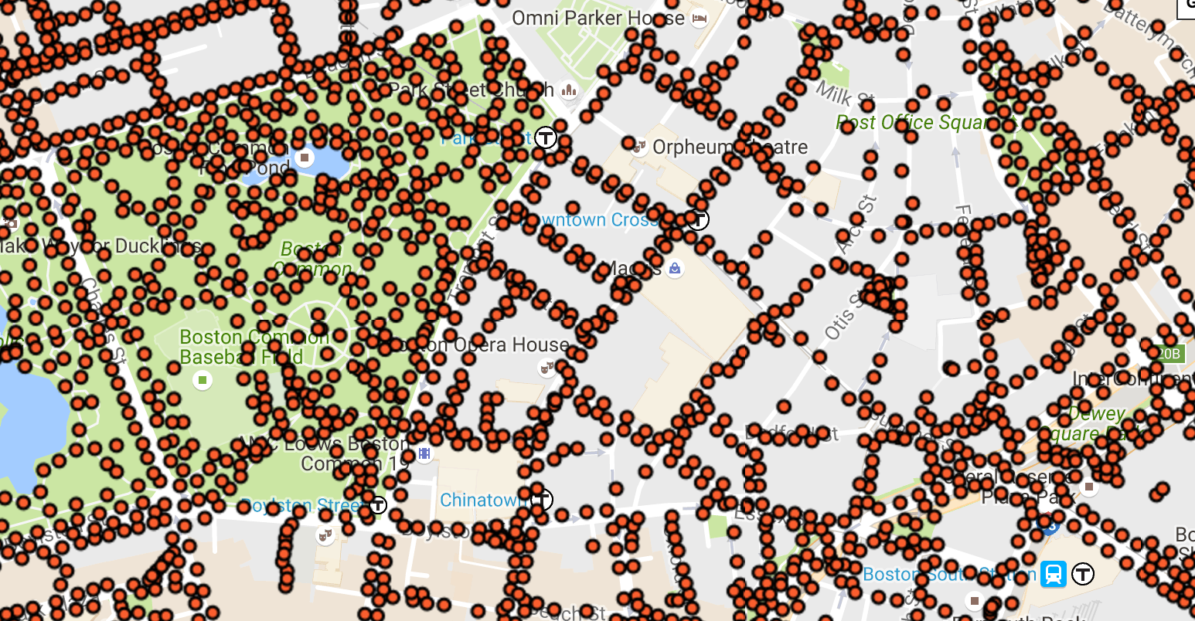
Open data
https://data.cityofboston.gov/
311 service requests
Many, many lists
Streetlight locations
Community gardens
Healthy corner stores
Hubway bike movement
BERDO Energy Reporting
Boston Indicators Project

Slide 7
Polls and opinion
Gallup World Poll
See Gallup folder in the Github repo
www.github.com/BITScity/2016/
TBA: “smart city engagement metrics”

Slide 8
Private data
Mobile device data
See slides from MIT Real Estate Innovation Lab and DES-X

